Slide 1
Operation Analytics and Investigating Metric Spike
Presented by :-
Souvik Karmakar

Slide 2
Description:
Embark on a journey into the realm of Operational Analytics with this engaging project, where the Lead Data Analyst plays a pivotal role in unraveling the intricacies of a company's operations. Collaborating closely with teams in operations, support, and marketing, the Lead Data Analyst tackles daily challenges, particularly in investigating metric spikes—unexpected shifts in critical indicators such as daily user engagement and sales.
Armed with advanced SQL skills, the Lead Data Analyst utilizes provided datasets and tables to answer questions from different departments, mirroring the responsibilities of a lead data analyst at a prominent company like Microsoft. This project goes beyond mere data analysis; it emphasizes leveraging analytical prowess to provide insights that drive operational enhancements and unveil the reasons behind sudden changes in key metrics. Participants can anticipate making a tangible impact on the company's success through astute, data-driven decision-making.

Slide 3
Objective 1: Job Data Analysis
Overview: The project involves a comprehensive analysis of job-related data stored in a table named job_data. The table comprises essential columns such as job_id, actor_id, event, language, time_spent, org, and ds (date in yyyy/mm/dd format). The primary focus is to extract meaningful insights from this dataset, shedding light on job-related activities.
Key Columns:
job_id: Unique identifier for each job.
actor_id: Unique identifier for each actor.
event: Type of event, categorized as decision, skip, or transfer.
language: Language of the content associated with the job.
time_spent: Duration spent reviewing the job in seconds.
org: Organization of the actor undertaking the job.
ds: Date of the event in yyyy/mm/dd format (stored as text).

Slide 4
Objective 2: Investigating Metric Spike
Overview: This case study involves investigating a metric spike using three tables: users, events, and email_events. Each table serves a distinct purpose in providing information about users, their actions, and specific events related to email activities. The primary goal is to identify and understand the causes behind a sudden spike in a key metric.
Key Tables:
users: Contains descriptive information about each user's account.
events: Captures various user actions, such as login, messaging, and search.
email_events: Focuses specifically on events related to the sending of emails.

Slide 5
Approach:-
The project was approached by first understanding the requirements and questions posed by different departments. The relevant datasets, such as jobData, users, events, and emailEvents, were collected and analyzed using SQL queries. The queries were designed to calculate specific metrics and derive meaningful insights. The results were then examined, and patterns and trends were identified. The analysis was performed iteratively, refining the queries and adjusting the approach as needed to ensure accurate and relevant insights.
Tech-Stack Used:-
The project utilized SQL for data analysis and query execution. The SQL queries were executed using tools such as MySQL Workbench 8.0.35.0 Community Edition. The purpose of using SQL was to efficiently extract, transform, and analyse the data from the provided datasets. The use of SQL allowed me for easy manipulation of the datasets and enabled the calculation of various metrics and insights based on the specific requirements.

Slide 6
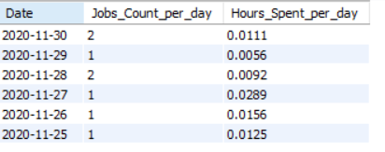
Case Study 1 :– Jobs data:
A. Number of jobs reviewed: Amount of jobs reviewed over time.
B. Task: Calculate the number of jobs reviewed per hour per day for November 2020?
SQL QUERY:-
SELECT ds AS Date, COUNT(job_id) AS Jobs_Count_per_day, sum(time_spent) / 3600 AS Hours_Spent_per_day FROM jobData WHERE ds >= '2020-11-01' AND ds <= '2020-11-30’ GROUP BY ds;

Slide 7
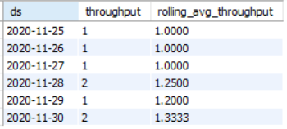
B.Throughput Analysis: Calculate the 7-day rolling average of throughput (number of events per second).
Task: Write an SQL query to calculate the 7-day rolling average of throughput. Additionally, explain whether you prefer using the daily metric or the 7-day rolling average for throughput, and why.
SQL Query:-
SELECT ds, COUNT(*) AS throughput, AVG(COUNT(*)) OVER(ORDER BY ds ROWS BETWEEN 6 PRECEDING AND CURRENT ROW) AS rolling_avg_throughput FROM jobData GROUP BY ds;

Slide 8
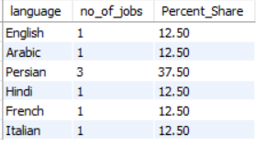
C.Language Share Analysis: Calculate the percentage share of each language in the last 30 days.
Task: Write an SQL query to calculate the percentage share of each language over the last 30 days.
SQL Query:-
with CommonT as (SELECT language, count(job_id) AS no_of_jobs FROM jobData GROUP BY language)
SELECT *, ROUND(no_of_jobs*100/(SELECT sum(no_of_jobs) FROM CommonT),2) as Percent_Share FROM CommonT;

Slide 9
D.Duplicate Rows Detection: Identify duplicate rows in the data.
Task: Write an SQL query to display duplicate rows from the jobData table.
SQL Query:-
Result:-
No duplicate rows .
SELECT ds, job_id, actor_id, org, COUNT(*) AS occurences FROM jobData GROUP BY ds , job_id , actor_id , org HAVING occurences > 1;

Slide 10
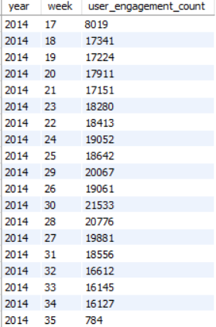
Case Study 2: Investigating Metric Spike
Weekly User Engagement: Measure the activeness of users on a weekly basis.
Task: Write an SQL query to calculate the weekly user engagement.
SQL Query:-
SELECT YEAR(occurred_at) AS year,
WEEK(occurred_at) AS week, COUNT(*) AS engagement_count
FROM events
WHERE event_type = 'engagement'
GROUP BY YEAR(occurred_at), WEEK(occurred_at), YEAR(occurred_at);

Slide 11
Result:-

Slide 12
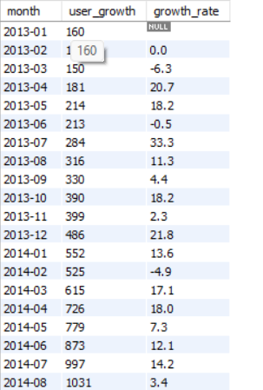
B. User Growth Analysis: Analyze the growth of users over time for a product.
Task: Write an SQL query to calculate the user growth for the product.
SQL Query:-
SELECT DATE_FORMAT(created_at, '%Y-%m') AS month, COUNT(DISTINCT user_id) AS user_growth, ROUND((COUNT(DISTINCT user_id) - LAG(COUNT(DISTINCT user_id)) OVER(ORDER BY DATE_FORMAT(created_at, '%Y-%m'))) / LAG(COUNT(DISTINCT user_id))OVER (ORDER BY DATE_FORMAT(created_at, '%Y-%m')) * 100, 1) AS growth_rate FROM users GROUP BY month ORDER BY month;

Slide 13
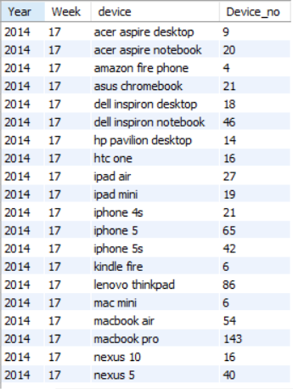
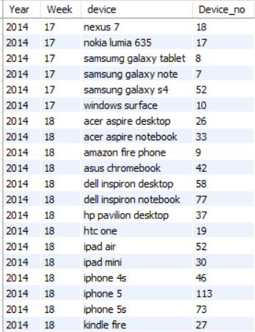
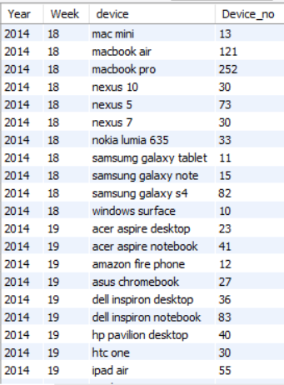
C. Weekly Retention Analysis: Analyze the retention of users on a weekly basis after signing up for a product.
Task: Write an SQL query to calculate the weekly retention of users based on their sign-up cohort.
SQL Query:-
Result:-
Link for the full result:- Retention rate result.xlsx
SELECT EXTRACT(year FROM occured_at)
AS Year, EXTRACT(week FROM occured_at)
AS Week, device, COUNT(DISTINCT(user_id)) as Device_no FROM events WHERE event_type = 'engagement' GROUP BY 1,2,3 ORDER BY 1,2,3 ASC;

Slide 14
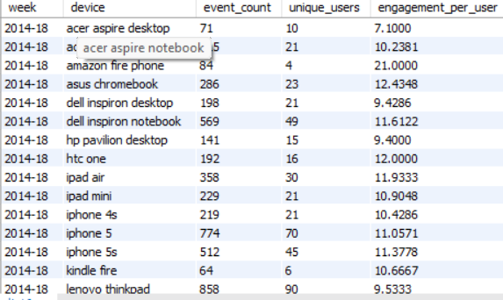
D. Weekly Engagement Per Device: Measure the activeness of users on a weekly basis per device.
Task: Write an SQL query to calculate the weekly engagement per device.
SQL Query:
Result:-
Link for full result - Weekly engagement rate.xlsx
SELECT
DATE_FORMAT(occurred_at, '%Y-%u') AS week,
device,
COUNT(*) AS event_count,
COUNT(DISTINCT user_id) AS unique_users,
COUNT(*) / COUNT(DISTINCT user_id) AS engagement_per_user
FROM events
GROUP BY week, device
ORDER BY week, device;

Slide 15

E. Email Engagement Analysis: Analyze how users are engaging with the email service.
Task: Write an SQL query to calculate the email engagement metrics.
SQL Query:-
SELECT ROUND
((100.0 *SUM(CASE WHEN action1 IN
('Email Clicked') THEN 1 ELSE 0 END)/SUM(CASE WHEN action1 IN ('Email Sent') THEN 1 ELSE 0 END)),2) AS Email_Click_Rate, ROUND((100.0 *SUM(CASE WHEN action_details IN ('Email Opened') THEN 1 ELSE 0 END)/SUM(CASE WHEN action_details IN ('Email Sent') THEN 1 ELSE 0 END)),2) AS Email_Open_Rate FROM Email_Data;

Slide 16
CONCLUSION:-
In conclusion, operational analytics and the investigation of metric spikes are crucial aspects of business management that should be conducted regularly, aligning with the specific needs of the firm. This analysis can be performed on a daily, weekly, monthly, quarterly, or yearly basis, depending on the business requirements and objectives.
Furthermore, prioritizing email engagement with customers is essential for fostering a strong relationship and expanding the customer base. Crafting compelling email content with attractive headings, coupled with offering reasonable discounts and coupons, can contribute significantly to customer retention and acquisition.
Additionally, it is advisable for firms to establish a dedicated department, if feasible, to address the concerns of visitors who abandon the sign-up process. Providing guidance and support to these individuals can be instrumental in converting them from mere visitors into valued customers. This proactive approach demonstrates a commitment to customer satisfaction and contributes to the overall success of the business.

